Slide 1
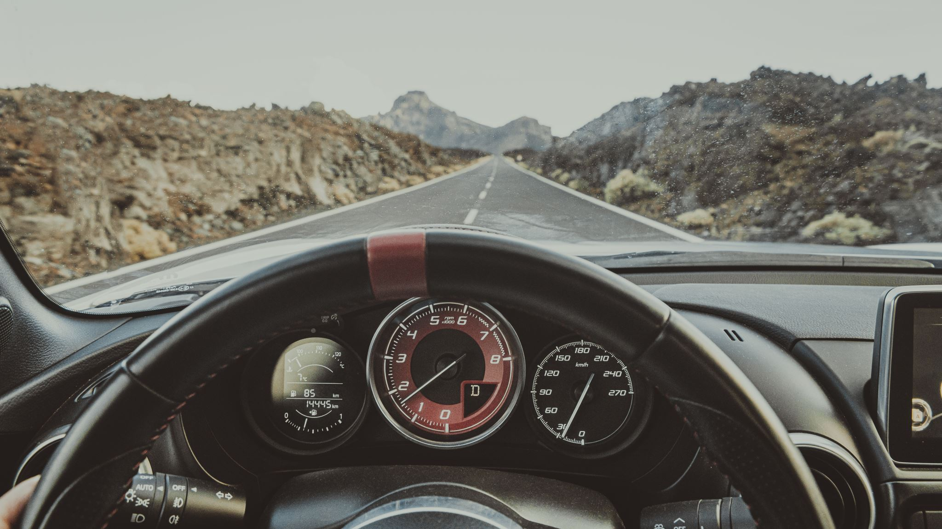
Self_Driving car
Task-1
Supervisor:
Dr.GAMAL EL-SHIKH

Slide 2

Team members
Abdelrahman Sherif Ali THE LEADER
Asmaa Mohamed Abdelhamed
Moamen Ahmed Mourad
Mohammed Alaa
Mahmod Mohamed
Mohamed Nageh
Sondos Reda Ghareeb
Mohamed Hossam

Slide 3
How it's going to be
The project idea
The connection between the web site & the car
Present the car while it’s working
Overview of the main component

Slide 4

The project idea
Control the car across the web site via the ESP8266 throughout the MPU6050 readings

Slide 5
The connection between the web site & the car
for controlling an autonomous car via an ESP8266 microcontroller. The system allows users to remotely control the car and view real-time data on its movements and actions by connecting to the ESP network which called Autonomous Car and password is auto2244 ,then can go to 192.168.1.100 which operates as the Server Side.

Slide 6



Slide 9
Present the car

Slide 10
The basic component
Mpu6050
Esp8266
HC-020k

